Slide 1



TITLE PAGE
Problem Statement: E-Commerce Website
Team Members:
1.Vraj
2.Ronik
Guide By: Viha Dave

Slide 2
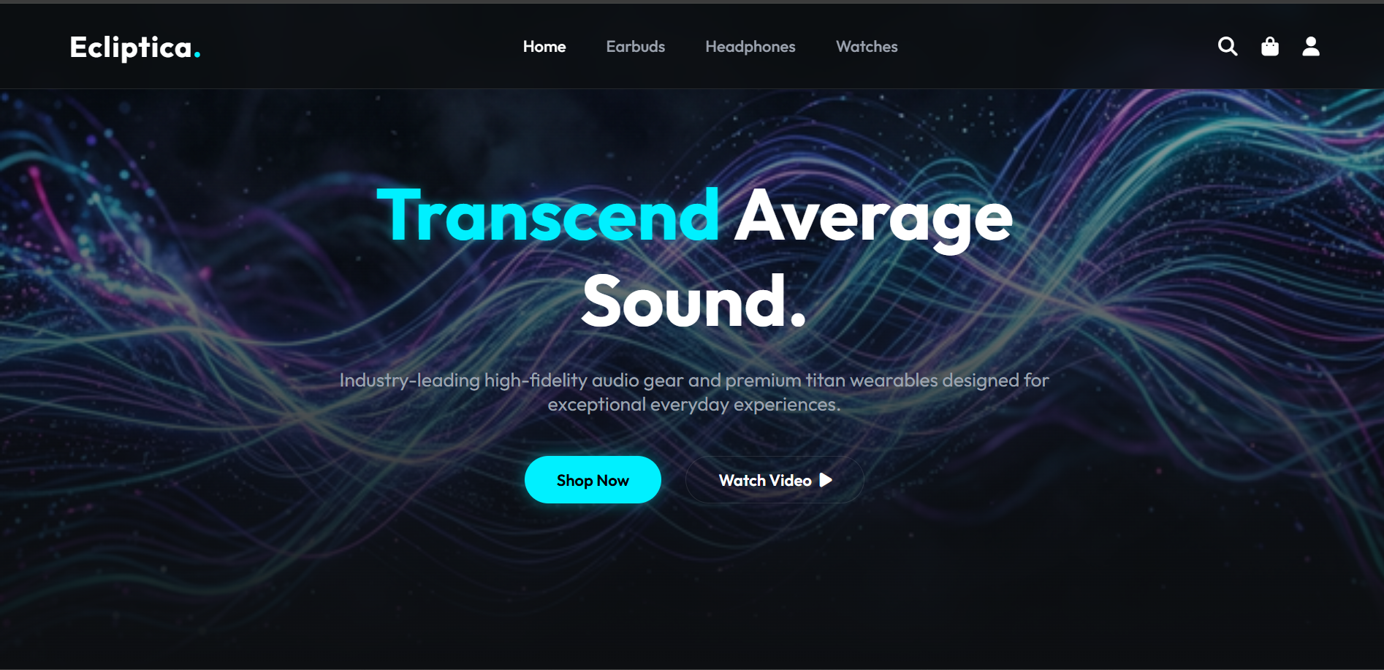
About the Website
A modern e-commerce homepage for selling products
like earbuds, headphones, and smart wearables.
Built using HTML, CSS, and JavaScript to create a responsive and interactive user interface.
Powered by Django with SQLite3 for backend logic, database management, and user authentication.
Includes core e-commerce features such as
product browsing, shopping cart, and secure user management.

Slide 3
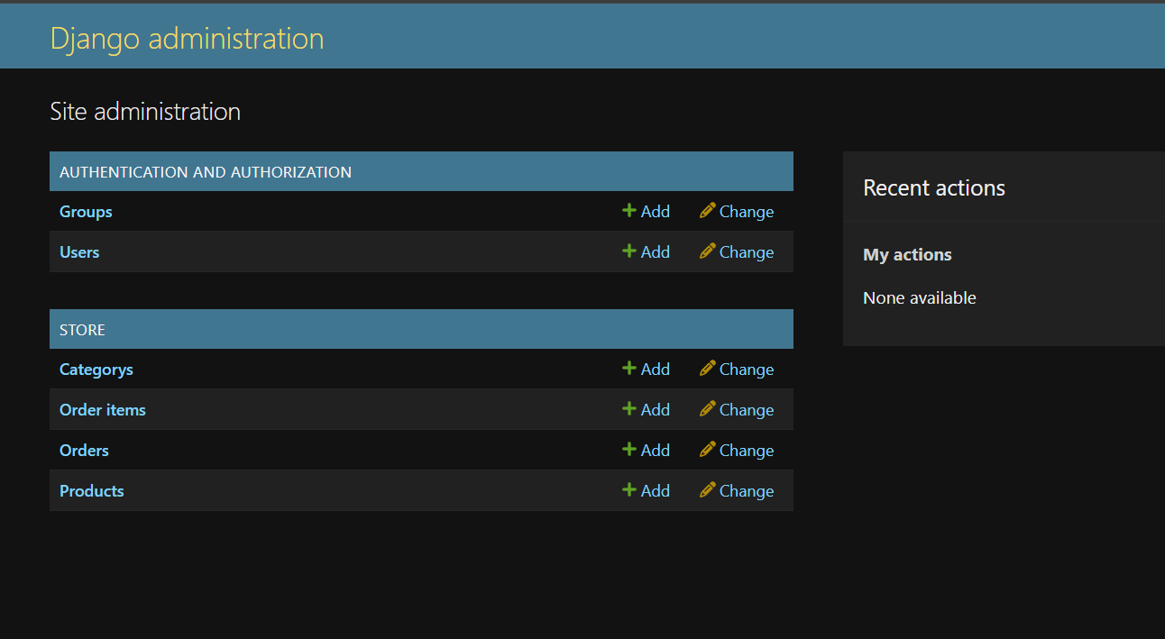
Features of the Website
Product browsing with categories
like earbuds, headphones, and watches.
User authentication for secure login
and account management.
Shopping cart system for adding and
managing products.
Django-powered backend with SQLite3 for smooth data handling and functionality.

Slide 4
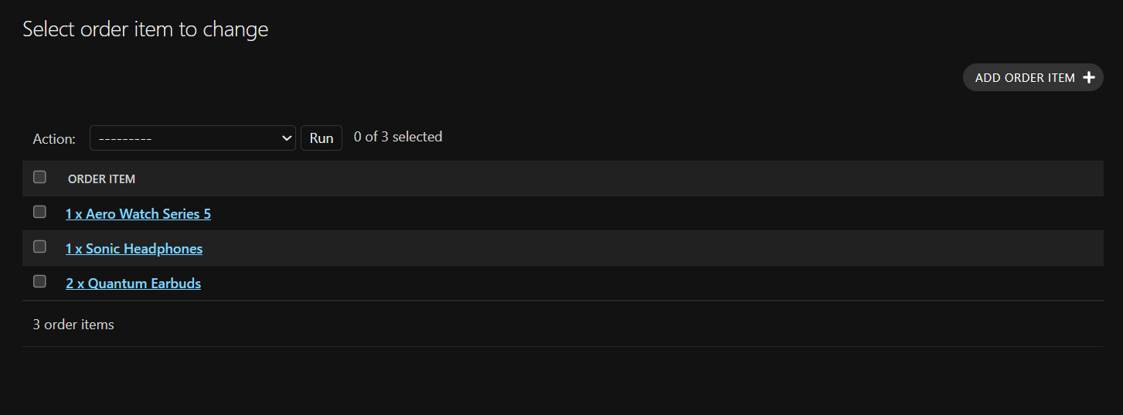
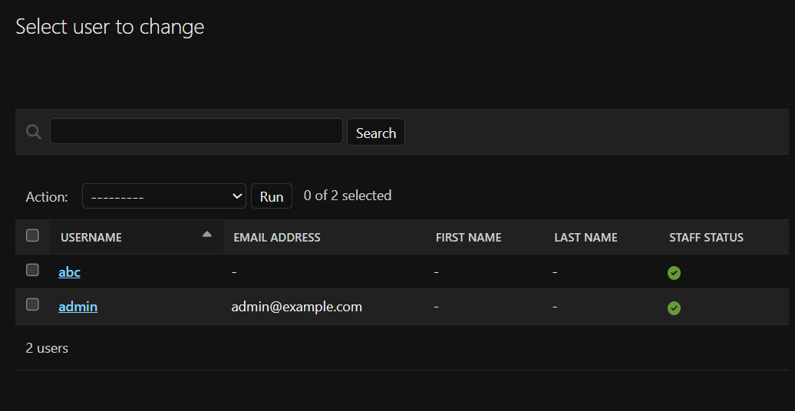
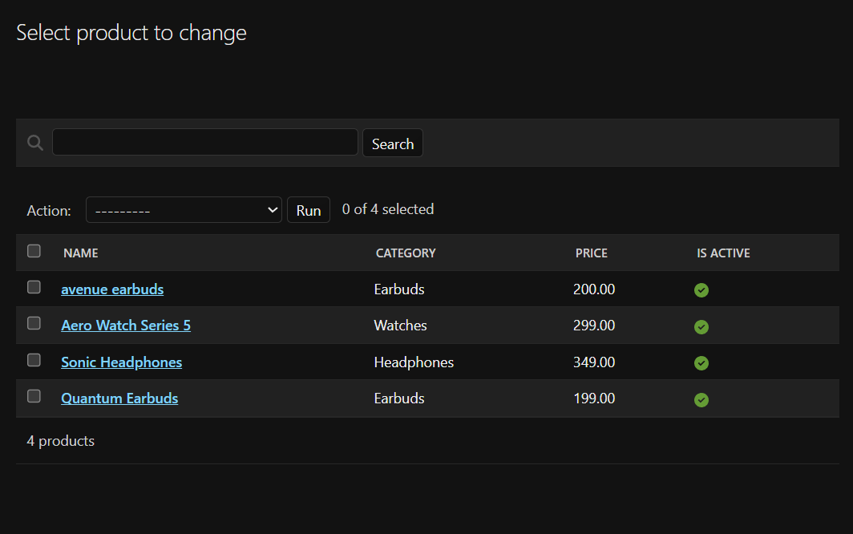
How It Works
Users browse products across categories like
earbuds, headphones, and watches.
Items can be added to the shopping cart for
easy purchase management.
The Django backend handles business logic, processes
requests, and manages authentication.
SQLite3 stores product and user data, while Django connects the
frontend and database for smooth functionality

Slide 5





Technologies Used
HTML, CSS, JavaScript – Used to build the responsive and interactive frontend interface.
Django (Python Framework) – Handles backend logic,user authentication, and server-side processing.
SQLite3 Database – Stores product information, user accounts, and application data.
Why Django over Flask?
Django was preferred because it provides built-in features like authentication, admin panel, and ORM, makingit faster and more secure for building full e-commerce systems.

